Slide 1
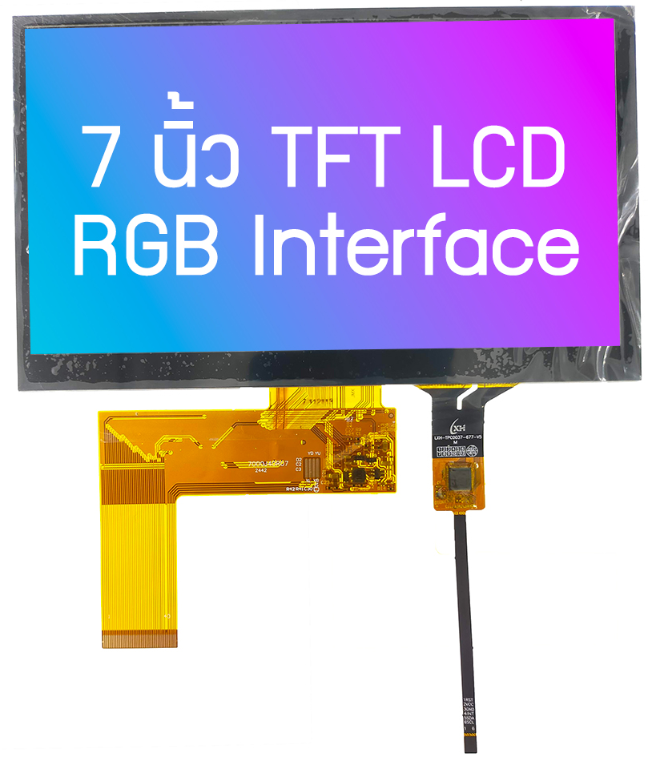

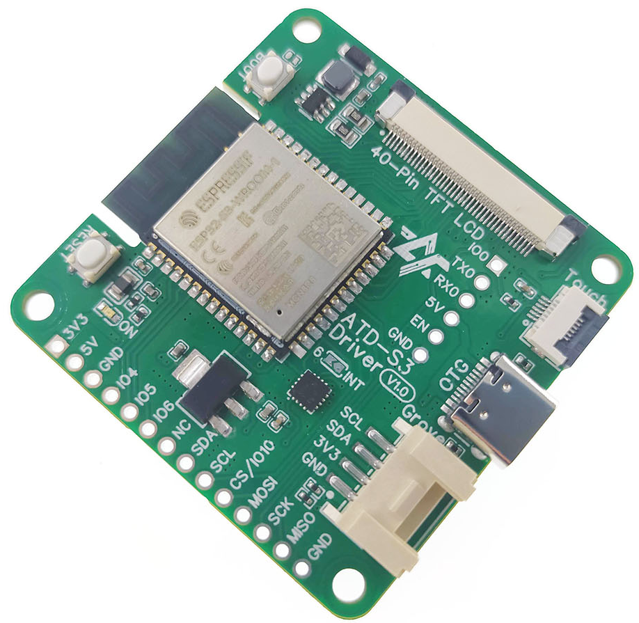

ATD-S3 Driver
LVGL Benchmark
ESP32-S3, 7-inch TFT LCD, 800x480px

Slide 2

Widget Demo
Board : ATD-S3 Driver
MCU : ESP32-S3
LVGL : V8.3.11
LCD : 7-inch RGB interface
Resolution: 800x480 Px

Slide 3
Benchmark
Board : ATD-S3 Driver
MCU : ESP32-S3
LVGL : V8.3.11
LCD : 7-inch RGB interface
Resolution: 800x480 Px

Slide 4
Music Demo
Board : ATD-S3 Driver
MCU : ESP32-S3
LVGL : V8.3.11
LCD : 7-inch RGB interface
Resolution: 800x480 Px

Slide 5






ติดต่อสอบถามเพิ่มเติม
www.ArtronShop.co.th
contact@atronshop.co.th
@artronshop
ArtronShop

